Slide 1
Intro to Signal Processing in Python
Presented by ACM SIGMusic

Slide 2
What You’ll Need
Python3
Recommended to install through conda
Numpy
Scipy
Matplotlib
Jupyter-Lab
The jupyter notebook file that goes with this presentation

Slide 3
How do computers represent sound?
‘Samples’ of audio taken from the real world at a fixed rate
This rate is called the ‘sampling rate’ often denoted as fs
The sample is a bit value corresponding to pressure that the mic picks up at the given time

Slide 4
More on sampling rate
The sampling rate must be at least twice the frequency of the highest frequency you want to represent on the computer
Called the Nyquist Frequency
Why? (show image)
Failing to obey this results in aliasing
This is why audio is often sampled at 44.1 kHz or 48 kHz

Slide 5
Time Domain Representation
Way you generally see audio plotted (like in a recording like audacity)
The ‘waveform’: x[n] = x[0] + x[1] + x[2] + … + x[n-1]
Great format for some data, but not always for audio
Not really how our brains and ears process audio

Slide 6
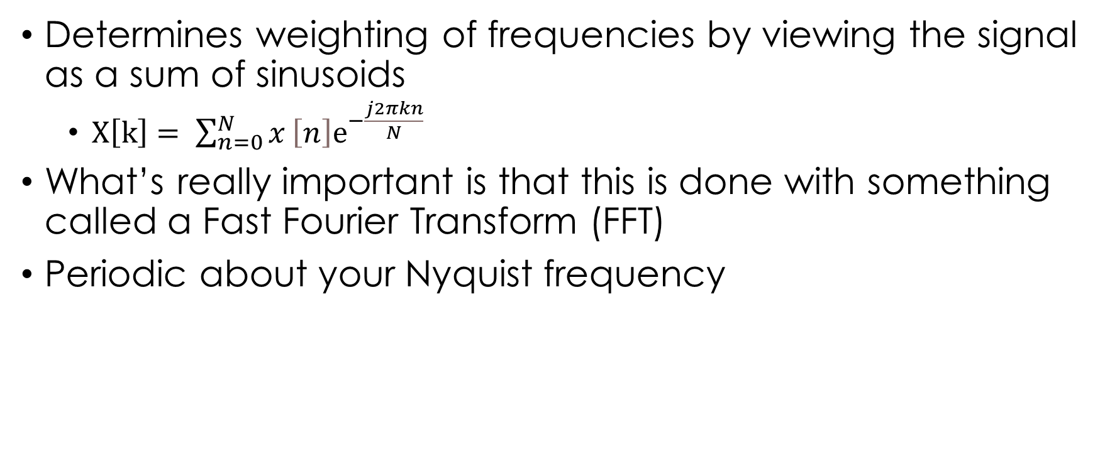
Frequency Domain Representation
Determines weighting of frequencies by viewing the signal as a sum of sinusoids
$X\left[k\right]= \sum_{n=0}^{N}{x}\left[n\right]ⅇ^{−\frac{j2πkn}{N}}$
What’s really important is that this is done with something called a Fast Fourier Transform (FFT)
Periodic about your Nyquist frequency

Slide 7
What if I don’t care about negative frequencies?
Generally you won’t for audio
Use a real FFT, faster and only positive frequencies

Slide 8
Time-Frequency Domain Representation
Most of the time audio isn’t a stable frequency all the time, like a sine wave
Solution: take bunch of FFTs in short intervals (windows)
Short Time Fourier Transform (STFT)
Tradeoff between time and frequency resolution
Longer window has more accurate frequency distribution, but worse timing accuracy

Slide 9
Windows
You can take slices of your input signal, but it leads to discontinuities
Solution: Have each window overlap with the next and previous and multiply each by something that smoothes it at beginning and end
Hanning, Hamming, Kaiser are common

Slide 10
Filters
Way to manipulate the audio content in interesting ways
Often used to remove or increase different frequencies in a sound
Like a graphic equalizer
Two design types
Finite Impulse Response (FIR) – safe, but more computationally intensive
Infinite Impulse Response (IIR) – can be unstable, ie. Produce bad output even for safe input

Slide 11
Filters - 2
Low Pass Filter (LPF)
Removes high frequencies, lets lows pass
High Pass Filter (HPF)
Removes low frequencies, lets highs pass
Bandpass Filter (BPF)
Removes frequencies outside the pass band
Bandstop Filter
Removes frequencies in the specified band

Slide 12
How can all of this be used?
Feature extraction
Audio effects
Noise reduction
Preprocessing for machine learning
Data visualization
Beyond music and audio
I’ve directly applied all of this to medical devices

